Slide 1
Word Embedding Based Correlation Model for Question Answer Matching Yikang Shen 등 6명 AAAI 2017
김태훈

Slide 2
1. 배경
QA의 Challenges
Lexical Gap : distance between dissimilar but potentiality related words in QA
Q : Where?
A : Korea!
Notes:
translation model
semantic model

Slide 3


2. Model - WEC(Word Embedding Correlation)
QA words Embedding : skip-gram
- dimension 500, window 10
Word-level Correlation Function : Euclidean norm
Sentence-level Correlation Function
M : translation matrix(dxd)
maps word in the answer into
a possible correlated word
in the question
home
where
M

Slide 4
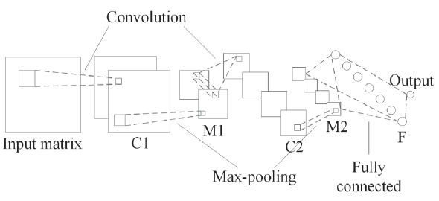
2. Model - CNN
bag-of-word schema의 단점
“white blood cells destroying an infection”
vs
“an infection destroying white blood cells”
To integrate both lexical and syntactical info
S+CNN 구조 반영

Slide 5
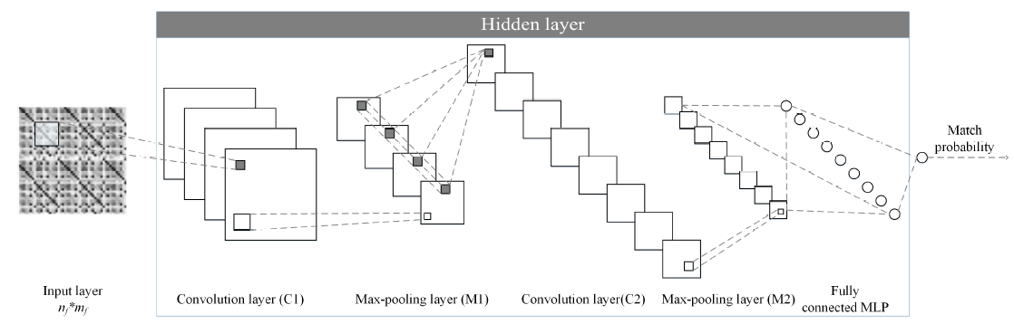
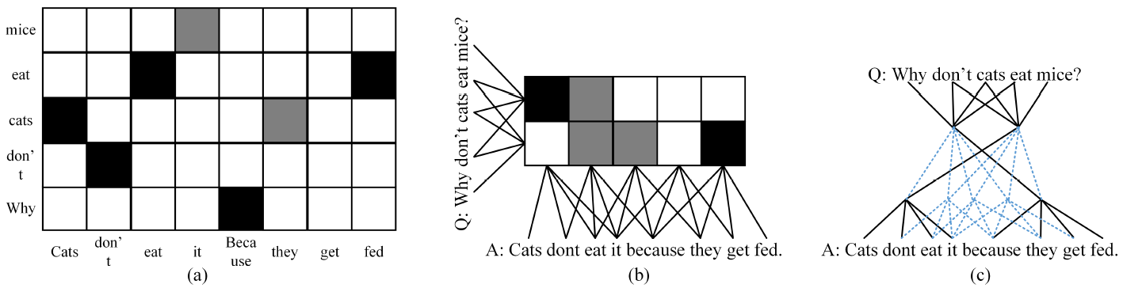
2. Model - S+CNN(IAAA 2015)
5x5 filter
20 feature
2x2
5x5 filter
50 feature
500 unit
2x2
darker grid – higher similarity
layer C1 result
relation after pooling

Slide 6
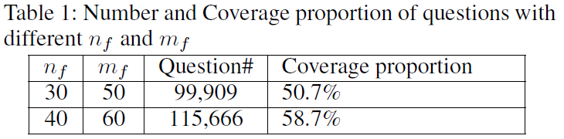
2. Model - input
1) Fix Input (as image)
Q : 30 words, A : 50 words
* converage 8.0% ▲, cost of memory 60% ▲

Slide 7
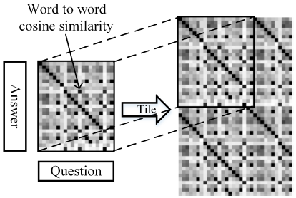
2. Model - input
2) Tiled Input
- S+CNN
- WEC
M * A

Slide 8

3. Experiment
□ Training
1st supervised pre-training M
2nd supervised training CNN part(fix M)
fine-tune step : all parameters in WEC and CNN
Q
A
M
1st training(WEC)
2nd training(CN)

Slide 9
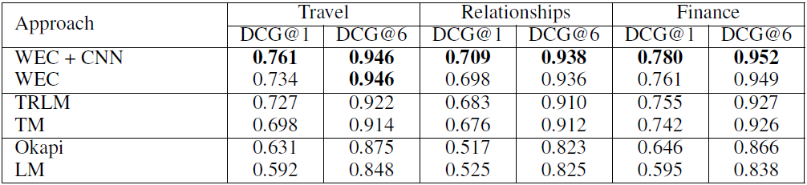
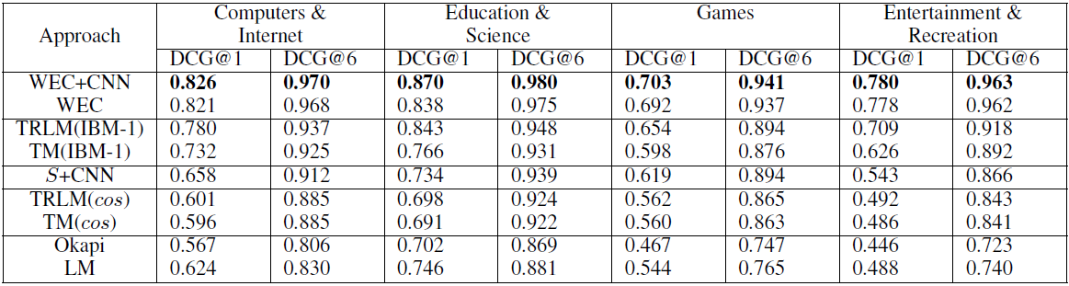
3. Experiment - result
Yahoo
Baidu

Slide 10
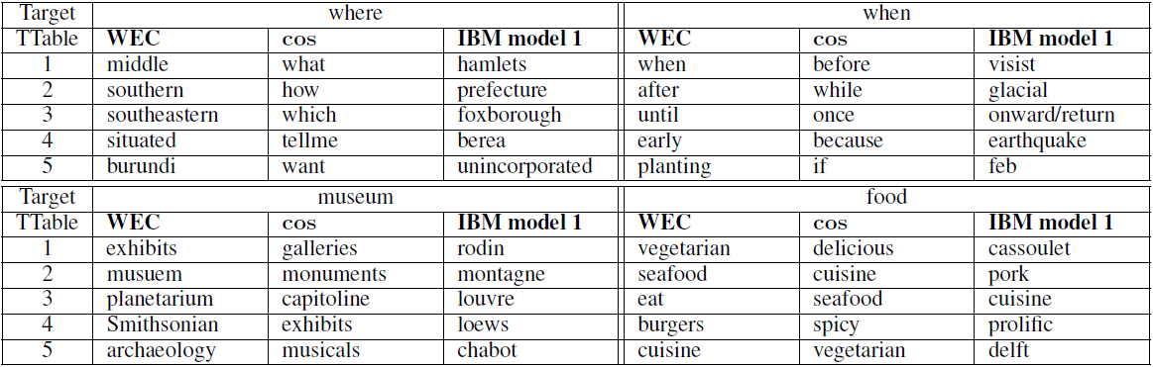
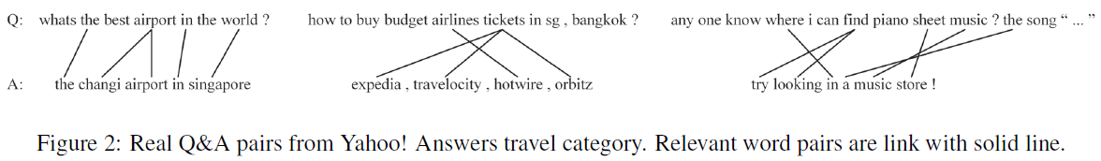
3. Experiment - result

Slide 11
4. Conclusion
QA problem에 CNN을 활용
translation matrix M 사용
다른 RNN 모델들과의 성능 비교도 있었으면…
Answer 여러개의 조합으로 종합적인 하나의 answer이 될 수는 없을까?
Answer에 대한 신뢰도를 표현할 수 있지 않을까?

Slide 12
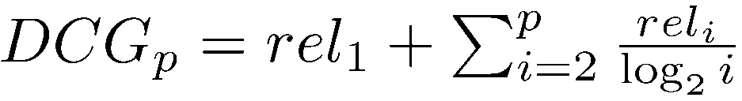
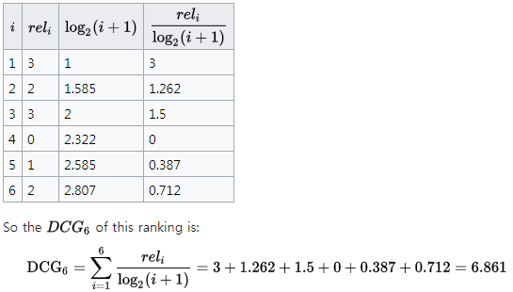
별첨# DCG(discounted cumulative gain)

